Slide 1
CS 211: Computer Architecture Digital Logic: Sequential Circuits
Abhishek Bhattacharjee
Reading:
Chapter 4: Section 4.2

Slide 2
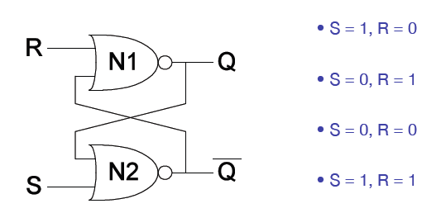
Set/Reset Latch

Slide 3
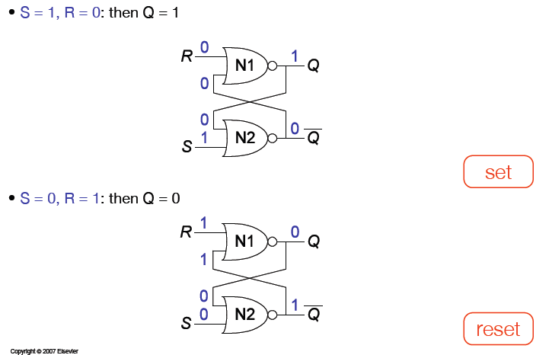
S/R Latch Analysis

Slide 4
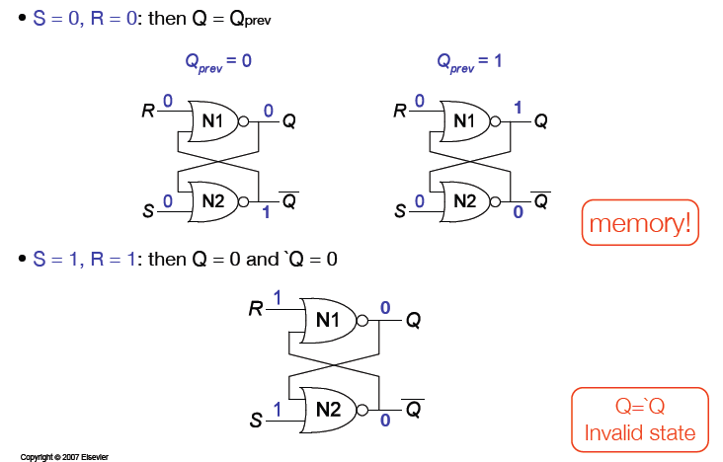
S/R Latch Analysis

Slide 5
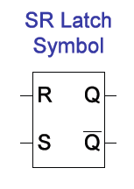
S/R Latch Symbol
Set operation – makes output 1 (S = 1, R = 0, Q = 1)
Reset operation – makes output 0 (S = 0, R = 1, Q = 0)
What about invalid state? (S = 1, R = 1)

Slide 6
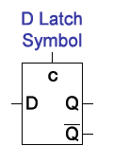
D Latch
Two inputs (C and D)
C: controls when the output changes
D (data input): controls what the output changes to
When C = 1, D passes through to Q (transparent latch)
When C = 0, Q holds previous value (opaque latch)

Slide 7
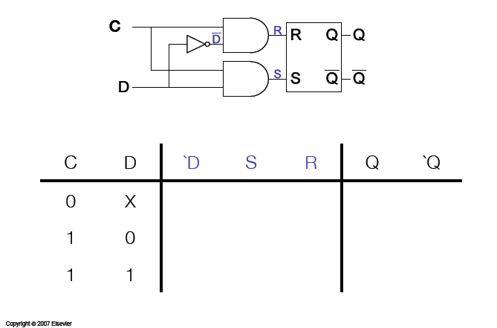
D Latch Internal Circuit

Slide 8
What are we going to do with Flip-Flops?
To do computations, we need more than just combinational circuits
We need to use past circuit state to influence future output
But how do we coordinate computations and the changing of state values across lots of different parts of a circuit?
We use CLOCKING (eg. 1GHz clock on Intel processors)
On each clock pulse, combinational computations are performed, and results stored in latches
How to introduce clocks into latches?

Slide 9
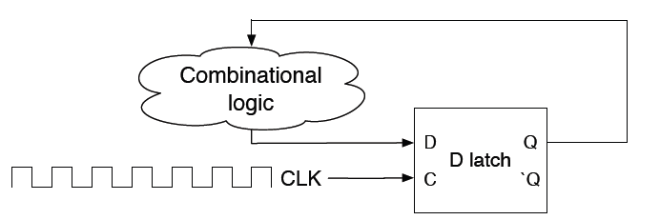
Flip-flops: Latches on a Clock
A straightforward latch is not safely synchronous (or predictably synchronous)
Flip-flops designed so that outputs will NOT change within a single clock pulse

Slide 10
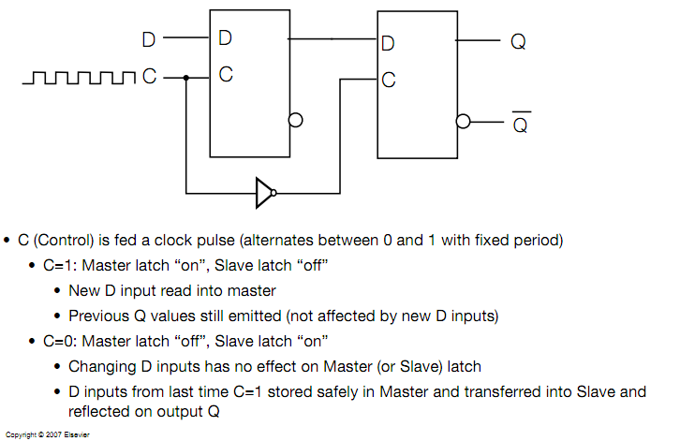
D Flip-Flop Summary

Slide 11
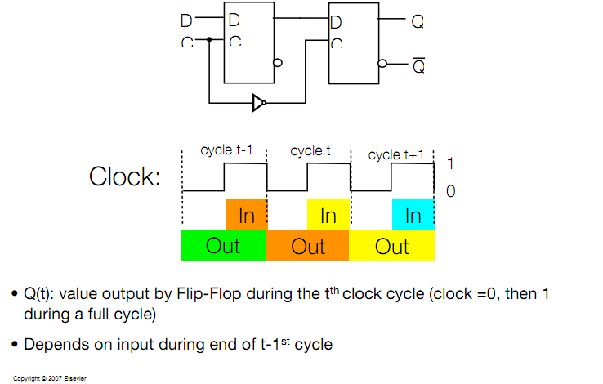
Flip-Flop Activation Time

Slide 12
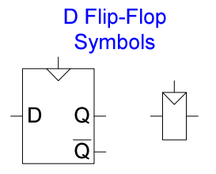
D Flip-Flop Summary
Two inputs: Clk, D
Function
The flip-flop samples D on rising clock edge
When clock goes from 0 to 1, D passes through Q
Otherwise, Q holds its value
Q only changes on rising clock edge
Flip-flop is called “edge-triggered” because it is activated only on the clock edge

Slide 13
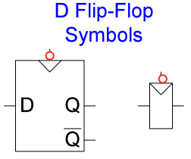
Negative Edge-Triggered D Flip-Flop
Two functions: Clk, D
Function
The flip-flop samples D on the falling edge of Clk
When Clk falls from 1 to 0, D passes through to Q
Otherwise, Q holds its previous values
Q changes only on the falling edge of Clk
A flip-flop is called an edge-triggered device because it is activated on a clock cycle

Slide 14
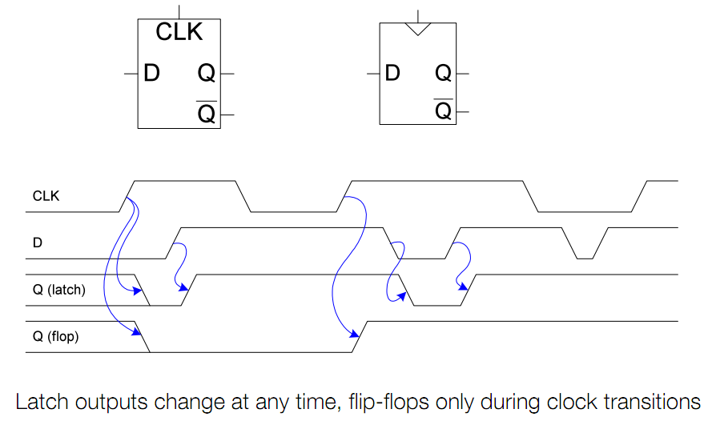
Flip-Flop versus Latch

Slide 15
Bit Storage Summary
We considered increasingly better bit storage until we arrived at the robust D flip-flop bit storage

Slide 16
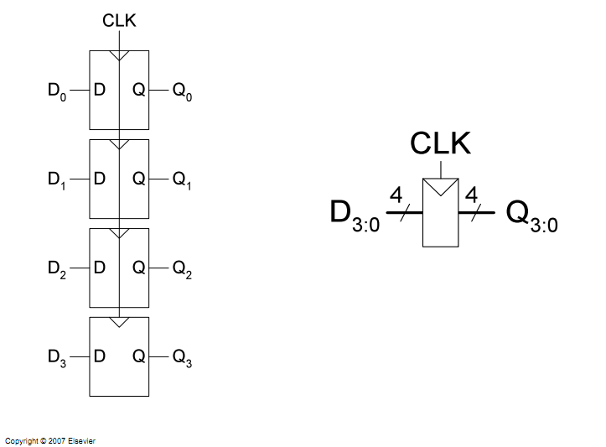
Registers

Slide 17
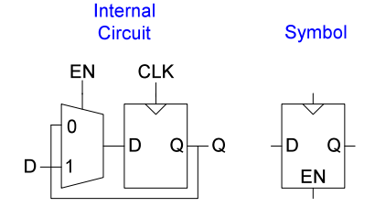
Enabled Flip-Flops
Inputs: Clk, D, En
The enable input (EN) controls when new data (D) is stored
Function
EN = 1: D passes through to Q on clock edge
EN = 0: the flip-flop retains its previous state

Slide 18
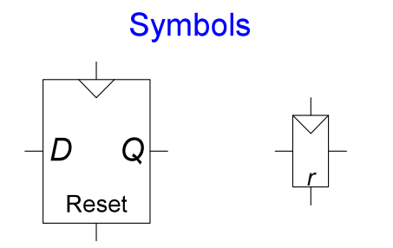
Resettable Flip-Flops
Inputs: Clk, D, Reset
Function
Reset = 1: Q is forced to 0
Reset = 0: the flip-flop behaves like an ordinary D flip-flop

Slide 19
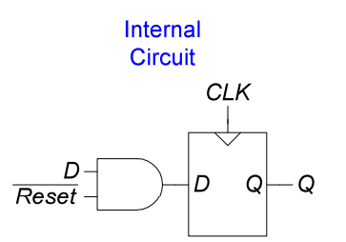
Resettable Flip-Flops (2)
Two types
Synchronous: resets at clock edge only
Asynchronous: resets immediately when Reset = 1
Asynchronously resettable flip-flop requires changing the internal circuitry of the flip-flop
What about synchronous design?

Slide 20

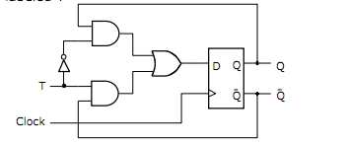

T Flip-Flop
This is a toggle flip-flop – when input T is 1, toggle output Q
Can be realized with a D flip-flop

Slide 21
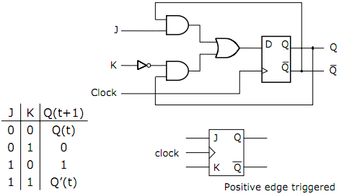
JK Flip-Flop
The JK Flip-Flop can also be derived from the basic D Flip-Flop
Its purpose it to combine aspects of the SR Flip-Flop and the T Flip-Flop
Behaves like an SR flip-flop for all values except J=K=1 (in these cases J = S, and K = R)
For J = K = 1, it toggles like a T flip flop
It can be built from a D flip flop

Slide 22
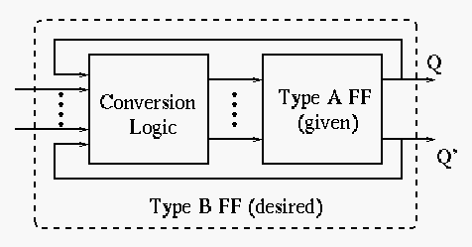
Flip-Flop Conversion
The purpose is to convert a given type A flip-flop to a desired type B flip-flop using conversion logic
The key is to use excitation tables, which show the necessary triggering signal (S, R, J, K, D, and T) for the desired flip-flop transition

Slide 23
Excitation Tables
Q(t) | Q(t+1) | S | R | J | K | D | T
0 | 0 | 0 | x | 0 | x | 0 | 0
0 | 1 | 1 | 0 | 1 | x | 1 | 1
1 | 0 | 0 | 1 | x | 1 | 0 | 1
1 | 1 | x | 0 | x | 0 | 1 | 0
This is the combination of input assignments (S, R, J, K, D, and T) required to realize state transitions

Slide 24
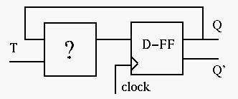
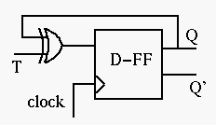
Convert a D-FF to a T-FF
We need to design the circuit to generate the triggering signal D as a function of T and Q → D = f(T, Q)
Consider the excitation tables of T and D
Make a k-map
Q(t)/T | 0 | 1
0 | 0 | 1
1 | 1 | 0
D = T’Q + TQ’ = T xor Q

Slide 25
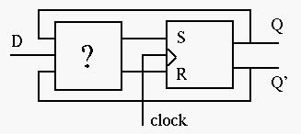
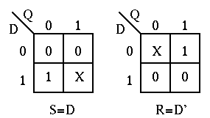
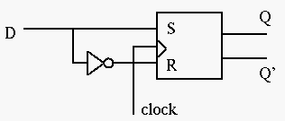
Convert an RS-FF to a D-FF
With above excitation tables, draw K-maps
So S = D, R = D’

Slide 26
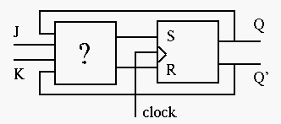
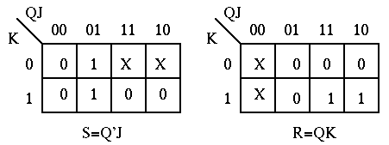
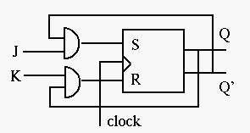
Convert an RS-FF to JK-FF

Slide 27
Synchronous Sequential Logic Design
Registers contain the state of the system
The state changes at the clock edge, so the system is synchronized to the clock
Rules of synchronous sequential circuit composition:
Every circuit is either a register or a combinational circuit
At least one circuit element is a register
All registers receive the same clock signal
Every cyclic path contains one register
Two common synchronous sequential circuits
Finite state machines (FSMs)
Pipelines

Slide 28
Shift Register
1 1 0 1
Register contents
Shift right
Move each bit one position right
Rightmost bit is “dropped”
Assume 0 shifted into leftmost bit
before shift right
0
a
0 1 1 0
Register contents
after shift right
Q: Do four right shifts on 1001, showing value after each shift
A:
1001 (original)
a
0100
0010
Implementation: Connect flip-flop output to next flip-flop’s input
0001
shr_in
a
0000

Slide 29
Shift Register
To allow register to either shift or retain, use 2x1 muxes
shr: “0” means retain, “1” shift
shr_in: value to shift in
May be 0, or 1
shr_in
shr
1
0
1
0
1
0
1
0
1
0
1
0
1
0
1
0
2x1
shr=1
2x1
D
D
D
D
D
D
D
D
Q
Q
Q
Q
Q
Q
Q
Q
Q3
Q2
Q1
Q0
Q3
Q2
Q1
Q0
(
b
)
(
a
)
shr_in
Left-shift register also easy to design
shr
Q3
Q2
Q1
Q0
(
c
)

Slide 30
Multifunction Registers
Many registers have multiple functions
Load, shift, clear (load all 0s)
And retain present value, of course
Easily designed using muxes
Just connect each mux input to achieve desired function
Functions:
s1
s0
Operation
0
0
Maintain present value
0
1
Parallel load
1
0
Shift right
1
1
(unused - let's load 0s)
shr_in
I3
I2
I1
I0
0
0
0
0
s1
3
2
1
0
3
2
1
0
3
2
1
0
3
2
1
0
s0
4x1
shr_in
I
3
I
2
I
1
I
0
s1
D
D
D
D
s0
Q3
Q2
Q1
Q0
Q
Q
Q
Q
Q3
Q2
Q1
Q0
(
b
)
(
a
)

Slide 31
Counters and Timers
4.9
N-bit up-counter: N-bit register that can increment (add 1) to its own value on each clock cycle
0000, 0001, 0010, 0011, ...., 1110, 1111, 0000
Count “rolls over” from 1111 to 0000
Terminal (last) count, tc, equals1 during value just before rollover
Internal design
Register, incrementer, and N-input AND gate to detect terminal count
0
0
1
a
0
0000
0001
0010
0011
0100
0
0101
0000
0001
1110
1
...
1111
a

Slide 32
Up/Down-Counter
Can count either up or down
Includes both incrementer and decrementer
Use dir input to select, via 2x1 mux: dir=0 means up
Likewise, dir selects appropriate terminal count value (all 1s or all 0s)
4-bit up/down counter
dir
1
4-bit 2
x
1
0
4
clr
clr
c
n
t
ld
4-bit register
4
4
4
4
4
–1
+1
4
4
1
2
x
1
0
t
c
C

Slide 33
Counter with Load
Up-counter that can be loaded with external value
Designed using 2x1 mux. ld input selects incremented value or external value
Load the internal register when loading external value or when counting
Note that ld has priority over cnt
L
4
ld
1
4-bit 2x1
0
4
cnt
Id
clr
clr
4-bit register
4
4
4
+1
tc
C

Slide 34
Counter with Parallel Load
1000
Useful to create pulses at specific multiples of clock
Not just at N-bit counter’s natural wrap-around of 2^{N}
Example: Pulse every 9 clock cycles
Use 4-bit down-counter with parallel load
Set parallel load input to 8 (1000)
Use terminal count to reload
When count reaches 0, next cycle loads 8.
Why load 8 and not 9? Because 0 is included in count sequence:
8, 7, 6, 5, 4, 3, 2, 1, 0 → 9 counts
4
ld
L
1
4-bit down-counter
c
n
t
t
c
C
clk
4

Slide 35
Register File
9
32
9
32
9
W_data
bus
R_data
Internal design uses drivers and bus
d0
load
reg0
9
driver
d0
2x4
32
9
2x4
1
d1
load
reg1
d1
1
a
9
driver
W_addr
i0
32
i0
1
i1
9
i1
1
R_addr
d
q
d2
load
reg2
d2
write
32
read
q=d
decoder
1
decoder
Boosts signal
d3
load
9
1
d3
e
reg3
9
9
e
W_en
32
R_en
three-state driver
1
4x32 register file
1
a
c
Internal design of 4x32 RF; 16x32 RF follows similarly
d
q
c=1: q=d
d
q
′
′
c=0: q= Z
d
q
like no connection
Note: Each driver in figure actually represents 32 1-bit drivers

